Slide 1
Why and When will Leaders of Developing County Negotiate South-North Preferential Trade Agreements?
Lucie Lu
Department of Political Science
September 19, 2018
Notes:
Today I will present to you the political motivations of leaders in developing countries to negotiate a specific type of trade agreement, the South-North preferential trade agreement. When and why are they more likely to do so? I hope this study can shed some new lights on understanding how leaders can use trade agreement as a political instrument to consolidate their power at home.

Slide 2
Research Question
Empirical puzzle: Preferential trade agreements (hereafter PTAs) negotiation between South Africa and the EU in 1994
Research question: Why and when will leaders in the developing country negotiate South-North preferential trade agreements with provisions of economic reforms?
Why important?
South-North PTA is rapidly growing.
A specific agreement, but contributes to a larger debate: Do PTAs change leaders’ behaviours, or leader self-select into the treaty?
Power imbalances reflect political costs and motives.
Notes:
Why is this an important question? One reason is the South-North PTA is popular. More and more leaders in the South and North have been recognizing the benefits of signing a bilateral trade agreement where both parties’ interests are easier to realize.
My answer to this question also contributes to a broader research debate: when leaders commit to the international agreement in general, is it because the agreement change their behaviours or they were planning to do so anyway before the commitment? This is crucial because it helps us to understand why leaders to commit to certain international agreement.

Slide 3
Context and Rationale
Two themes in the literature:
Effects vs. Causes of PTAs
What are the gaps in the literature?
Treat PTA as unit of analysis
Focus on subcategory of PTAs, the most costly ones.
Overlook a key actor
Literature only looked at median voters¹, interest groups², and private sectors³.
Strategic interactions between leader and opposition.
1. Mansfield & Milner, 2012; Mansfield, Milner, & Rosendorff, 2002.
2. Grossman and Helpman, 1995.
3. Staiger & Tabellini, 1999.
Notes:
Current literature on the PTA mainly focuses on the effects. And other literatures zoom into the domestic factors within the states to explain the cause, which is the theme that this paper speaks to. One of the gaps in this literature is scholars tend to treat the PTA as a unitary concept. They overlook the different degrees of policy changes embedded in the PTA designs. Few studies reach beyond trade liberalization to examine the role of the PTA in policy reform. This paper fixes the gap by examining the deepest and most costly subcategory of the PTAs and argues the leaders’ commitments to such agreement reflect their political purposes.
The existing theoretical framework also only focuses on the following domestic actors to explain why leaders sign trade agreements: median voters, interest groups or private sectors. Within these frameworks, leaders generally use the international trade agreements to signal the domestic audiences of their welfare-enhancing economic policy. I argue it is deficient to examine the motivation as economically driven only. I find a key player is missing: the opposition. What is overlooked is that leaders negotiate PTAs for political reason. To advance the literature on understanding the cause of PTA formation, this paper focuses on the strategic interactions between the leader and the opposition.

Slide 4
Argument
A leader negotiates PTAs after political crisis to punish the opponents’ past transgression. PTA negotiation is a deliberate choice that a leader makes to commit to the binding and stringent policy reforms to rearrange the domestic power structures.

Slide 5
Theory
Economic reform as a political strategy
Non-crisis Political Post-crisis
Crisis
repress
rent
repress more
retract rent
power
survive
punishment
Leader:
Opposition:
threatening demands
Economic reform is a powerful tactic to punish the defectors.

Slide 6
Theory (II)
(II) Why negotiating a PTA with major liberal powers?
a) PTA as a signal: opposition’s cooperation
b) PTA as a mechanism to redistribute rent from trade:
Disloyal opponents Loyal opponents
Reform
Reform
Side-payment
My Framework:
Political crisis Economic reforms
PTA
Notes:
In sum, after being hit by a shock, a leader can choose economic reforms to punish the disloyal opposition. Leaders are more likely to implement economic reform when the PTAs negotiation is in place.

Slide 7
Research Design
Hypothesis:
Negative shocks to a leader's security increase the probability of PTA negotiations.
(Hypothetical Treatment)
Shock to Leader’s Security
+
South-North PTA Negotiation
Research Design:
Compares the likelihoods of the South-North PTAs negotiation in:
Leaders with shocks to security
Leaders without shocks to security

Slide 8
Research Design (II)
Measure the Security of a Leader:
1) A leader's security before he starts his tenure at time 0 (Svolik 2012);
leader’s relation to the past
2) The security of the regime at time t (political effectiveness score in the state fragility index).
political effectiveness score > 0.
Identify Leaders with Shocks to Security (Hypothetical Treatment):
1) Type 1: a leader has a negative shock to security at time 1.
2) Type 2: a leader has a negative shock to security at time t.

Slide 9
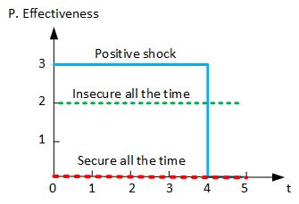
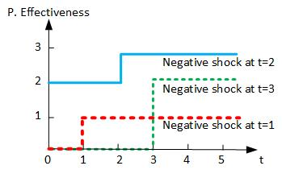
Who are Treated?
Control group Treated group

Slide 10
Examples in Datasets
Unit of analysis: Leader-Year
Country | Year | Leader | Regime | R.T. Past | P. Eff | PTA Nego.
Albania | 1997 | Fatas | Dem. | NA | 1 | 0
Albania | 1998 | Fatas | Dem. | NA | 2 | 0
Algeria | 1995 | Zeroual | Dict. | Regime | 2 | 0
Algeria | 1996 | Zeroual | Dict. | Regime | 2 | 1
Algeria | 1997 | Zeroual | Dict. | Regime | 2 | 0
Algeria | 1998 | Zeroual | Dict. | Regime | 2 | 0
Algeria | 1999 | Zeroual | Dict. | Regime | 2 | 0
Unit of analysis: Leader
Country | Leader | Tenure | Regime | R.T. Past | P. Eff | Shock(Z) | PTA Nego.
Albania | Fatas | 2 | Dem. | NA | shock_t | 1 | 0
Algeria | Zeroual | 5 | Dict. | Regime | shock_t1 | 1 | 1

Slide 11
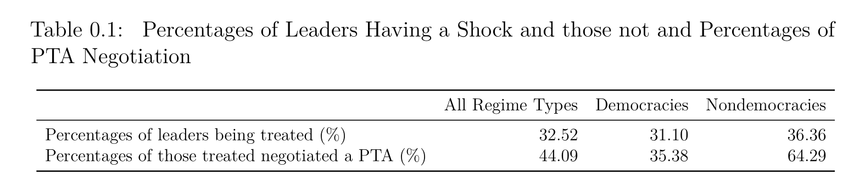
Empirical Findings: Data Description
There are 93 events out of 286 total observations.

Slide 12
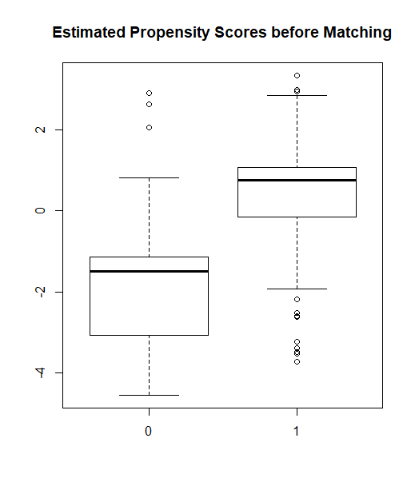
Empirical Findings: Propensity Score Before Matching

Slide 13
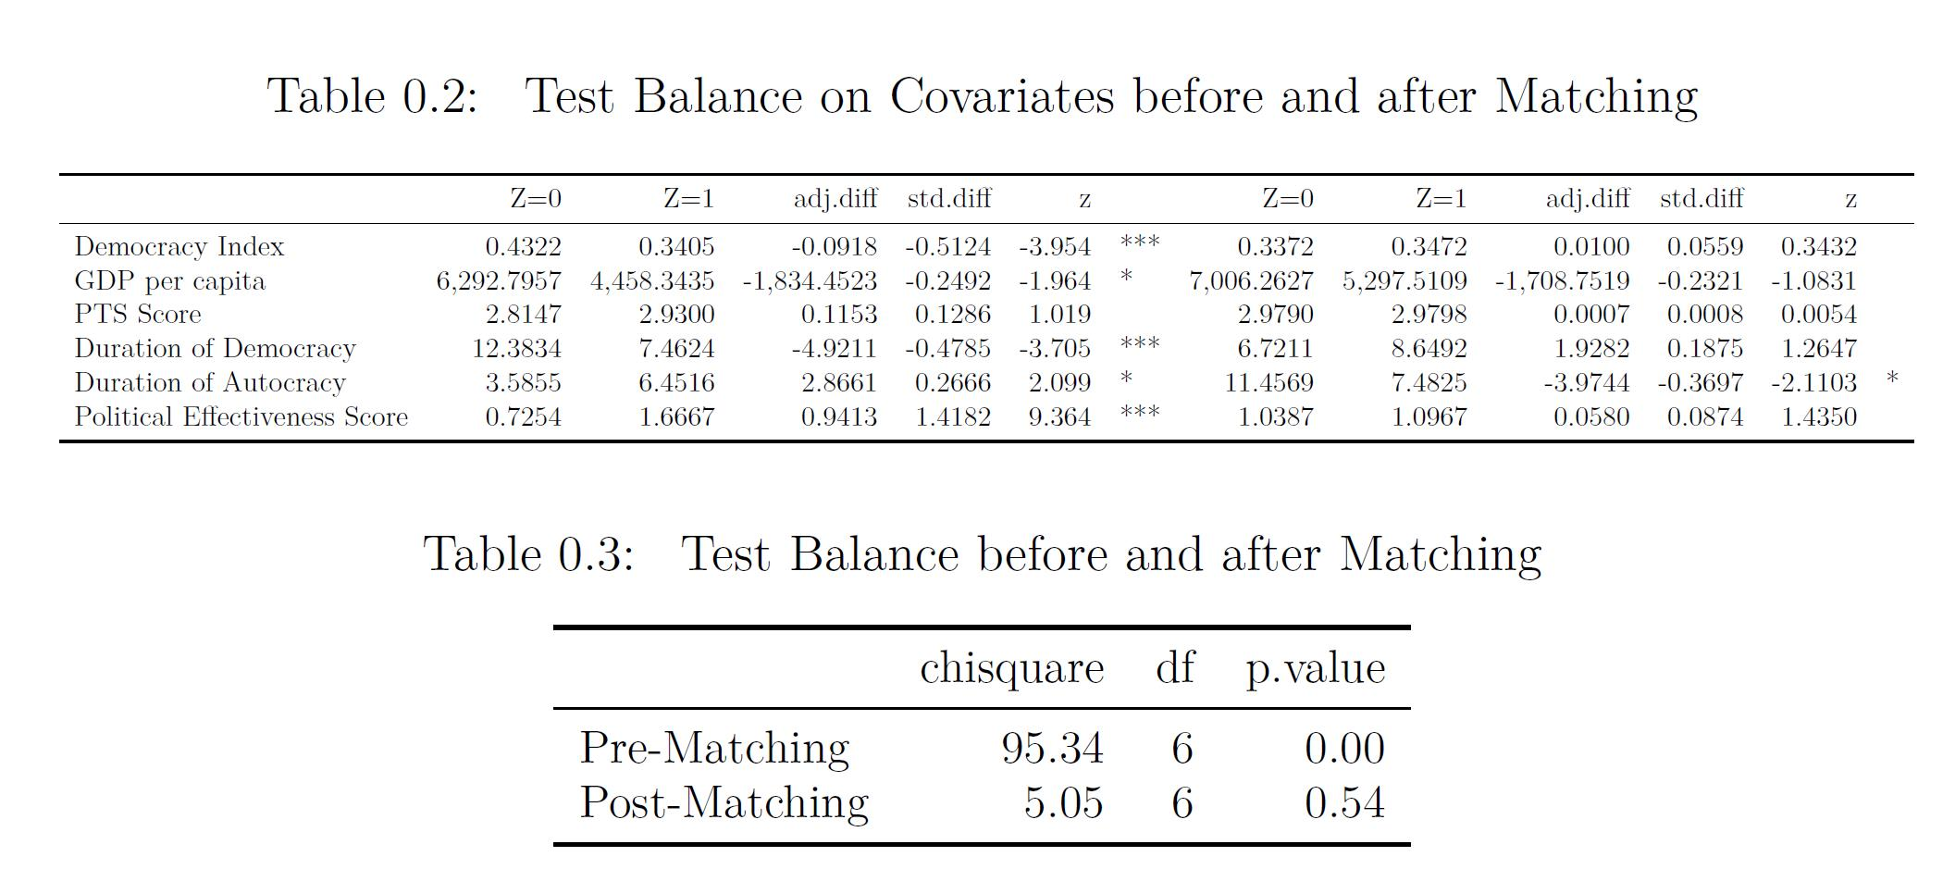
Empirical Findings: Propensity Score After Matching

Slide 14
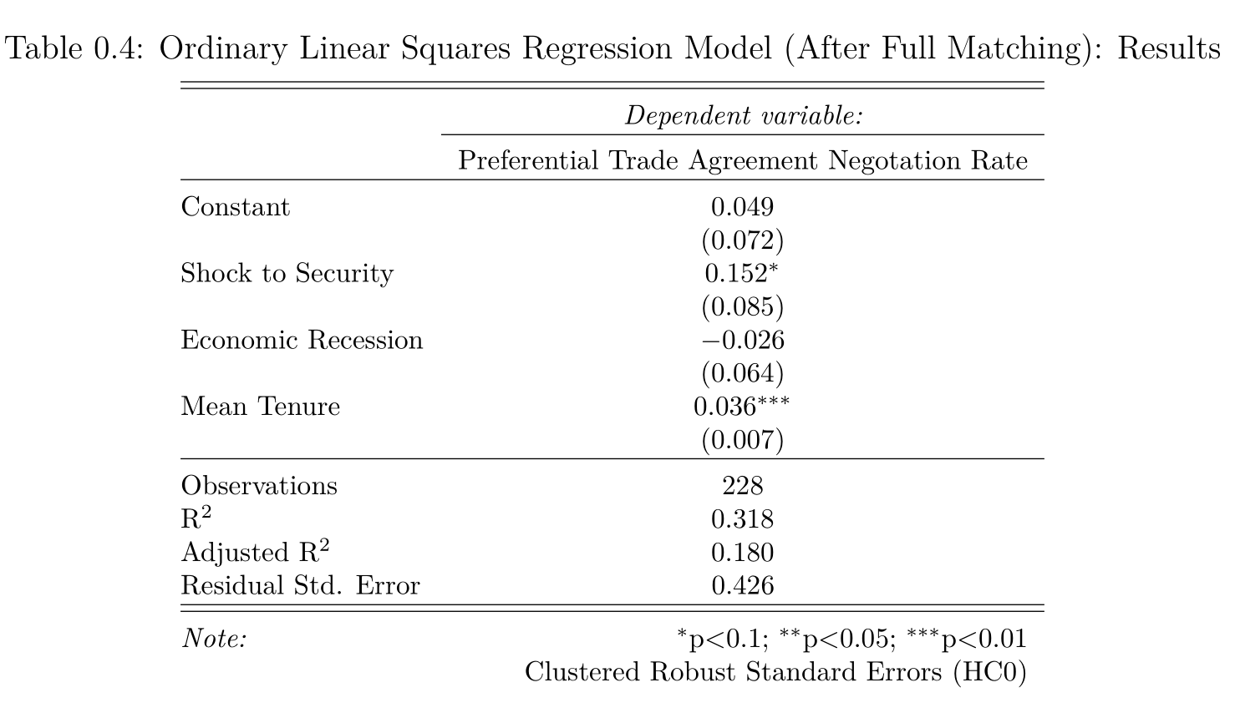
Empirical Findings: Treatment Effect After Matching

Slide 15
Conclusion
Main Take-away:
When leaders experience a political crisis, they are more likely to negotiate a South-North preferential trade agreement with the provision of economic reforms.
Future Work:
Explore whether PTA negotiation helps leaders to conduct economic reforms
Use a multilevel analysis
Notes:
hello

Slide 16
Appendix I Research Design (III)
Unit of analysis: leader
The dataset covers 286 leaders in 62 developing countries from 1995 to 2015.
Exclude liberal democracies
Exclude leaders whose tenure is less than one year
Dependent Variable: South-North PTA negotiation
Independent Variable: Negative Shocks to Security
Matching on the Covariates:
Regime Type (V-Dem’s Electoral Democracy Index)
Human Rights Conditions (PTS Score)
Regime Duration (Archigos, 2016)
GDP per capita (World Bank)
Confounding Variables in the OLS Model:
Leaders’ tenure (Archigos, 2016)
Negative Economic Growth (World Bank)

Slide 17
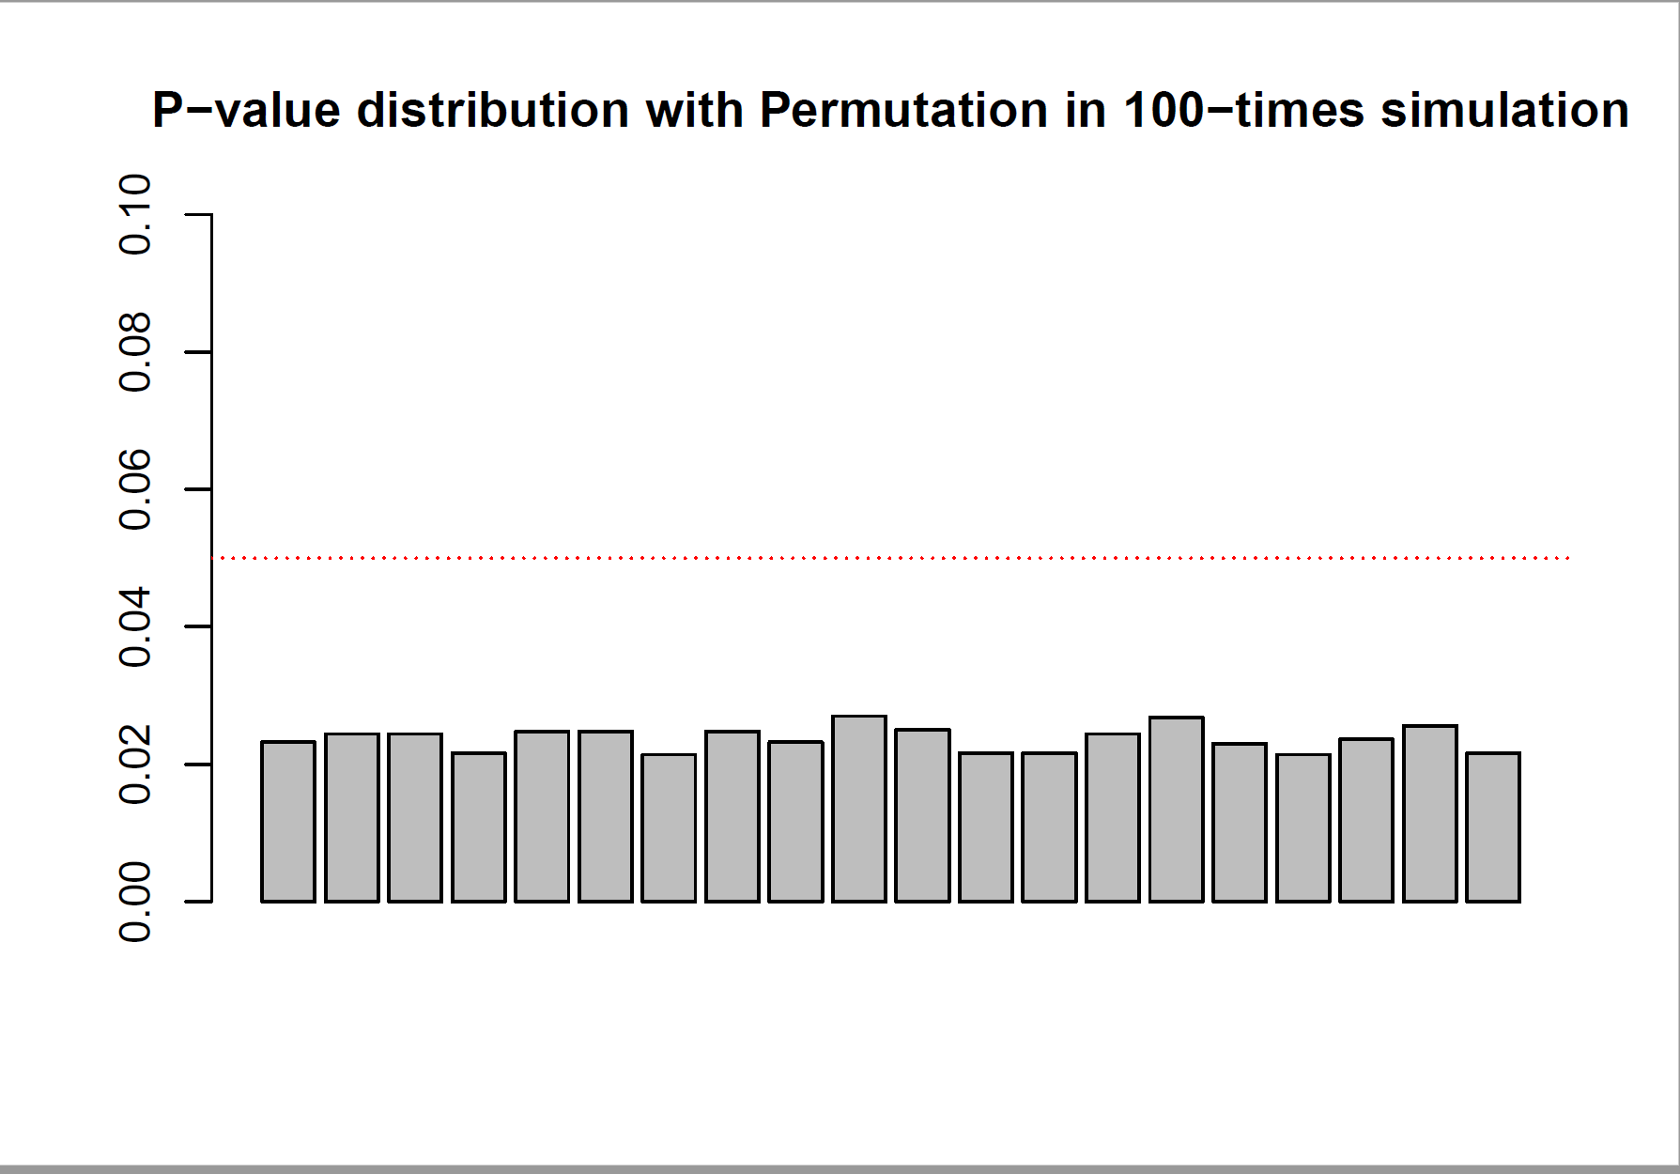
Appendix II Check Error Rates

Slide 18
References
Baccini, L., & Urpelainen, J. (2014). International Institutions and Domestic Politics: Can Preferential Trading Agreements Help Leaders Promote Economic Reform? The Journal of Politics, 76(1), 195–214. https://doi.org/10.1017/S0022381613001278
Bagwell, K., & Staiger, R. W. (1998). Will Preferential Agreements Undermine the Multilateral Trading System? The Economic Journal, 108(449), 1162–1182. https://doi.org/10.1111/1468-0297.00336
Baldwin, R. E. (2012). A Domino Theory of Regionalism. In G. Hufbauer & K. Suominen (Eds.), The Economics of Free Trade. Volume 2. (pp. 416–439). Elgar Research Collection. The International Library of Critical Writings in Economics, vol. 262. Cheltenham, U.K. and Northampton, Mass.: Elgar.
Bilal, S., & Laporte, G. (2004). How David Prepared to Talk to Goliath? South Africa’s experience of negotiating trade with the EU.
Dür, A., Baccini, L., & Elsig, M. (2014). The Design of International Trade Agreements: Introducing a New Dataset. The Review of International Organizations, 9(3), 353–375. https://doi.org/10.1007/s11558-013-9179-8
Grossman, G. M., & Helpman, E. (1995). The Politics of Free-Trade Agreements. The American Economic Review, 85(4), 667–690.
Kuran, T. (1991). Now out of Never: The Element of Surprise in the East European Revolution of 1989. World Politics, 44(01), 7–48. https://doi.org/10.2307/2010422
Mansfield, E. D., & Milner, H. V. (2012). Votes, Vetoes, and the Political Economy of International Trade Agreements. Princeton University Press. Retrieved from https://muse-jhu-edu.proxy2.library.illinois.edu/book/30505
Mansfield, E. D., Milner, H. V., & Rosendorff, B. P. (2002). Why Democracies Cooperate More: Electoral Control and International Trade Agreements. International Organization, 56(3), 477–513.
Mansfield, E. D., & Reinhardt, E. (2003). Multilateral Determinants of Regionalism: The Effects of GATT/WTO on the Formation of Preferential Trading Arrangements. International Organization, 57(4), 829–862.
Regan, P. M., & Henderson, E. A. (2002). Democracy, threats and political repression in developing countries: Are democracies internally less violent? Third World Quarterly, 23(1), 119–136. https://doi.org/10.1080/01436590220108207
Rodrik, D. (1992). The Rush to Free Trade in the Developing World: Why So Late? Why Now? Will it Last? (No. w3947). Cambridge, MA: National Bureau of Economic Research. https://doi.org/10.3386/w3947
Schamis, H. E. (1999). Distributional Coalitions and the Politics of Economic Reform in Latin America. World Politics, 51(2), 236–268. https://doi.org/10.1017/S0043887100008182
Staiger, R. W., & Tabellini, G. (1999). Do Gatt Rules Help Governments Make Domestic Commitments? Economics & Politics, 11(2), 109–144. https://doi.org/10.1111/1468-0343.00055
Wintrobe, R. (1998). The political economy of dictatorship /. Cambridge, UK ; Cambridge University Press,.

